Slide 1


Object lifetime,
Memory management.
Multithreading
Speaker:
Ivan Hlabets

Slide 2

Agenda
Allocating objects
Application root
Object generations
System.GC type
Building Finalizable Objects
Building Disposable Objects
Process
Thread
CLR ThreadPool
Synchronization
Task
async/await

Slide 3
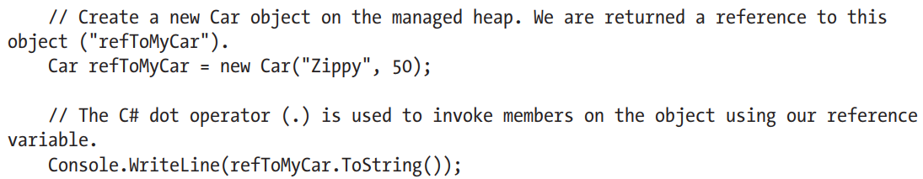
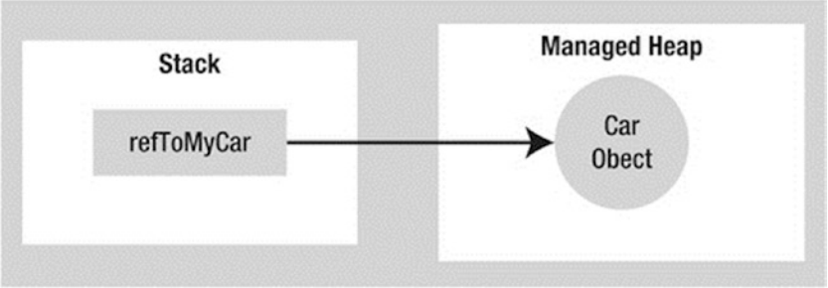
Allocating objects

Slide 4
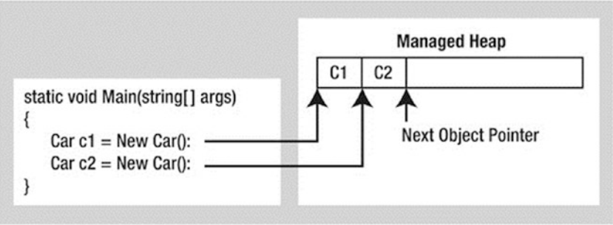
Allocating objects
Next object pointer:
- Calculate the total amount of memory required for the object to be allocated.
- Examine the managed heap to ensure that there is indeed enough room to host the object to be allocated. If there is, the specified constructor is called, and the caller is ultimately returned a reference to the new object in memory, whose address just happens to be identical to the last position of the next object pointer.
- Finally, before returning the reference to the caller, advance the next object pointer to point to the next available slot on the managed heap.

Slide 5
Application root
Application root is a storage location containing a reference to an object on the managed heap.
- References to global objects (though these are not allowed in C#, CIL code does permit allocation of global objects)
- References to any static objects/static fields
- References to local objects within an application’s codebase
- References to object parameters passed into a method
- References to objects waiting to be finalized (described later in this chapter)
- Any CPU register that references an object
During a garbage collection process, the runtime will investigate objects on the managed heap to determine whether they are still reachable (i.e., rooted) by the application. To do so, the CLR will build an object graph, which represents each reachable object on the heap.

Slide 6
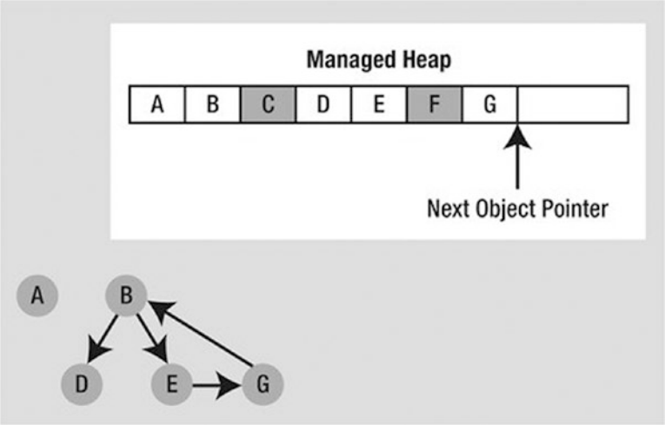
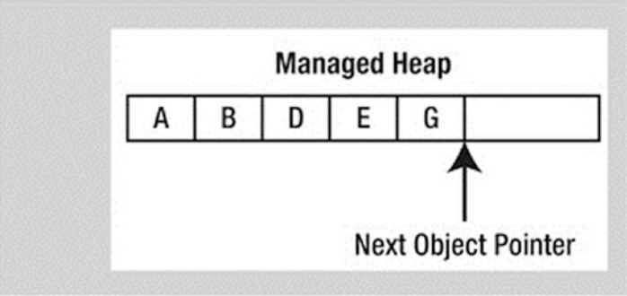
Application root

Slide 7
Object generations
The idea behind generations is simple: the longer an object has existed on the heap, the more likely it is to stay there.
- Generation 0: Identifies a newly allocated object that has never been marked for collection
- Generation 1: Identifies an object that has survived a garbage collection (i.e., it was marked for collection but was not removed because the sufficient heap space was acquired)
- Generation 2: Identifies an object that has survived more than one sweep of the garbage collector

Slide 8
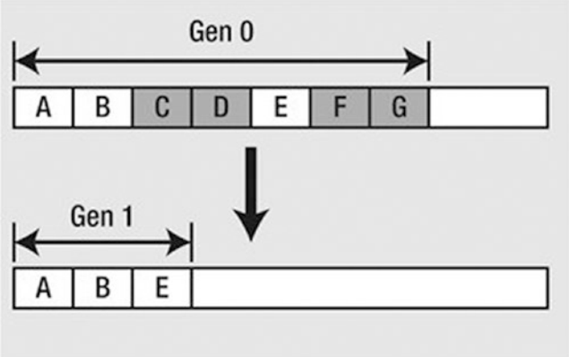
Object generations
Generations 0 and 1 are termed ephemeral generations.

Slide 9
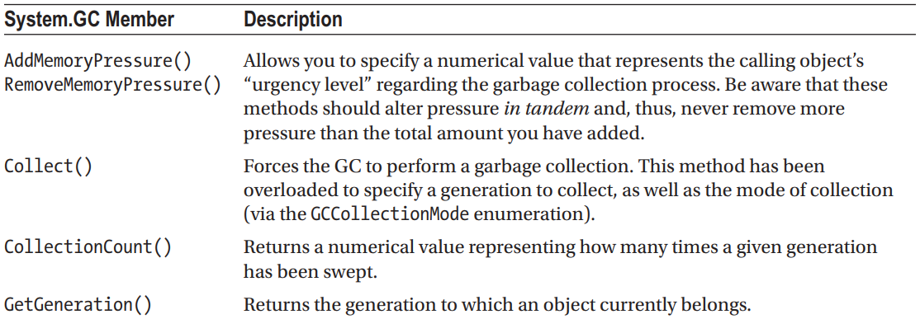
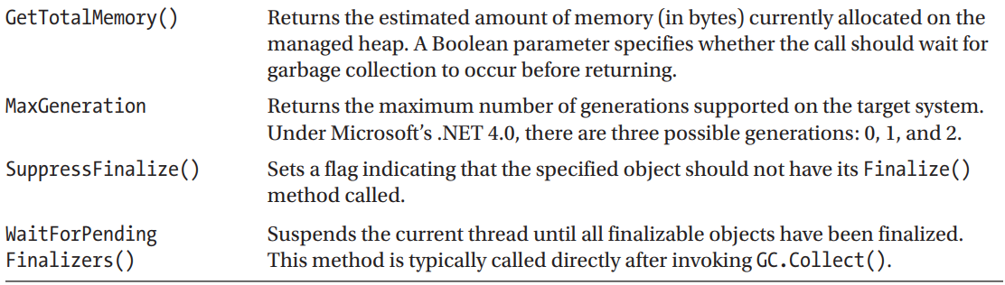
System.GC type

Slide 10
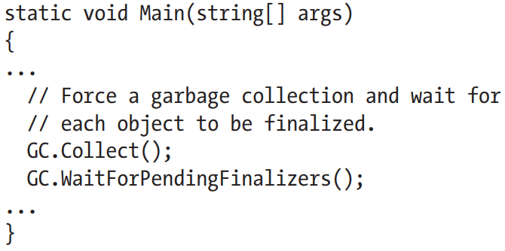
Forcing a Garbage Collection
Two common situations where you might consider interacting with the collection process:
Your application is about to enter into a block of code that you don’t want interrupted by a possible garbage collection.
Your application has just finished allocating an extremely large number of objects and you want to remove as much of the acquired memory as soon as possible.
The GC.Collect() method can also be supplied a numerical value that identifies the oldest generation on which a garbage collection will be performed.

Slide 11
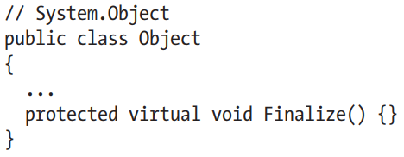
Building Finalizable Objects
This member is defined as protected, it is not possible to directly call an object’s Finalize() method from a class instance via the dot
operator. Rather, the garbage collector will call an object’s Finalize() method (if supported) before removing the object from memory.
It is illegal to override Finalize() on structure types. This makes perfect sense given that structures are value types, which are never allocated on the heap to begin with and, therefore, are not garbage collected!
The only time you would need to design a class that can clean up after itself is when you are using unmanaged resources (such as raw OS file handles, raw unmanaged database connections, chunks of unmanaged memory, or other unmanaged resources).

Slide 12
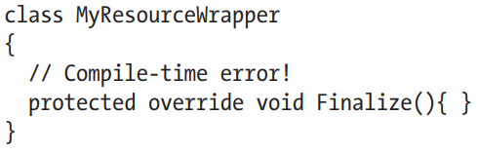
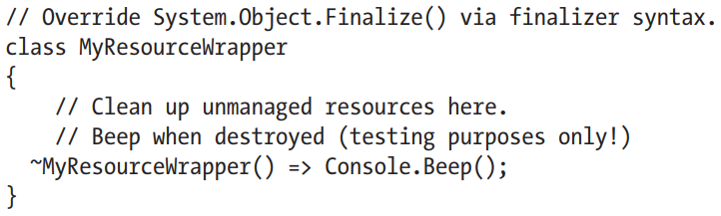
Overriding Finalize()

Slide 13
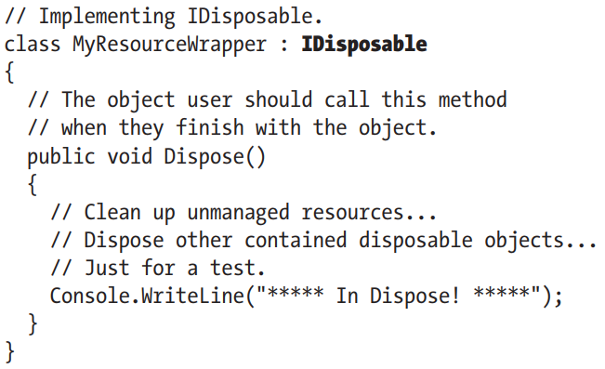
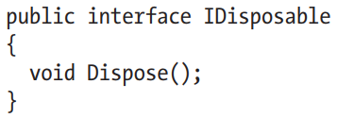
Building Disposable Objects

Slide 14
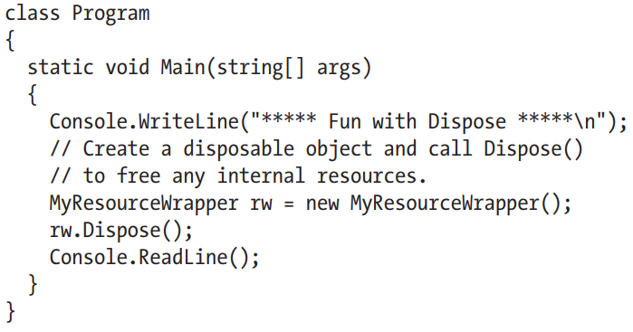
Building Disposable Objects
It is a good idea to call Dispose() on any object you directly create if the object supports IDisposable. The assumption you should make is that if the class designer chose to support the Dispose() method, the type has some cleanup to perform. If you forget, memory will
eventually be cleaned up (so don’t panic), but it could take longer than necessary.

Slide 15
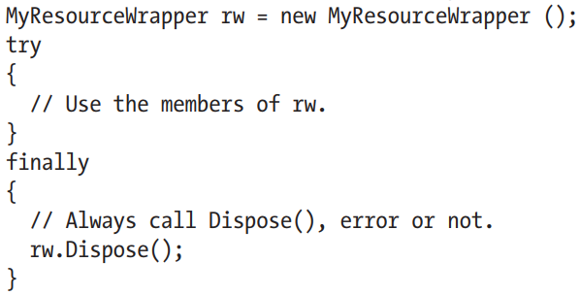
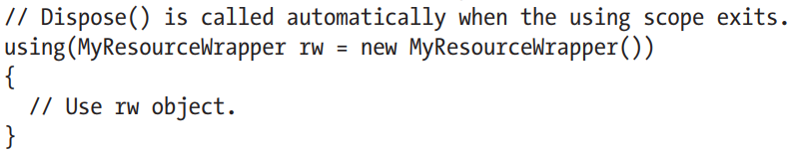
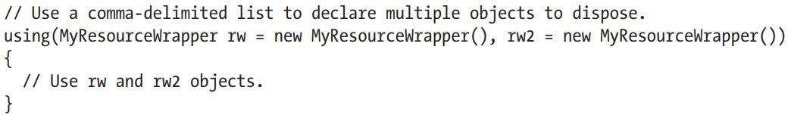
Building Disposable Objects

Slide 16
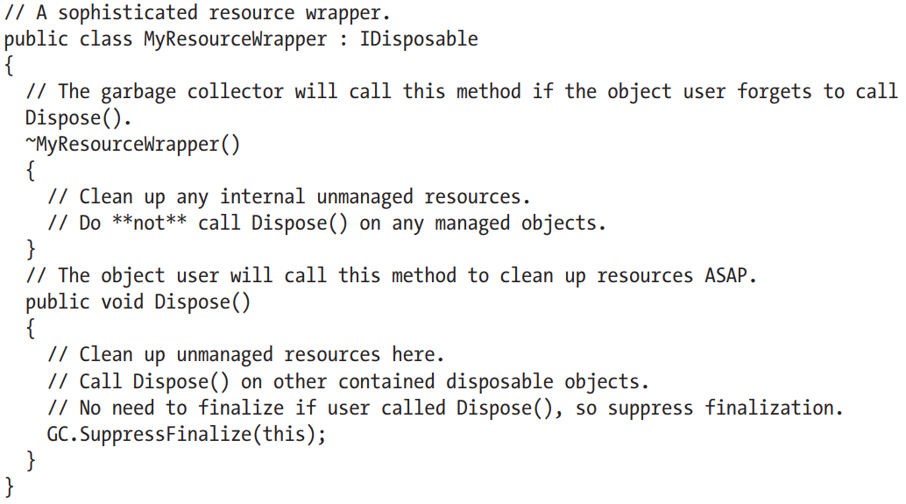
Building Disposable Objects

Slide 17
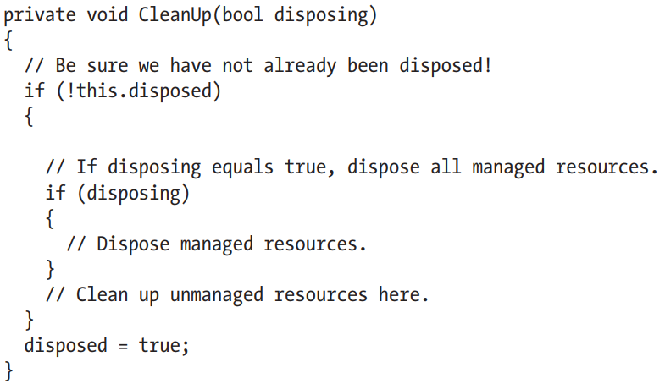
Building Disposable Objects

Slide 18
Process
A Process component provides access to a process that is running on a computer. A process, in the simplest terms, is a running app.
The Process component is a useful tool for starting, stopping, controlling, and monitoring apps. You can use the Process component, to obtain a list of the processes that are running, or you can start a new process. A Process component is used to access system processes. After a Process component has been initialized, it can be used to obtain information about the running process.
Info:
https://docs.microsoft.com/en-gb/dotnet/api/system.diagnostics.process?view=netframework-4.8
https://metanit.com/sharp/tutorial/18.1.php

Slide 19


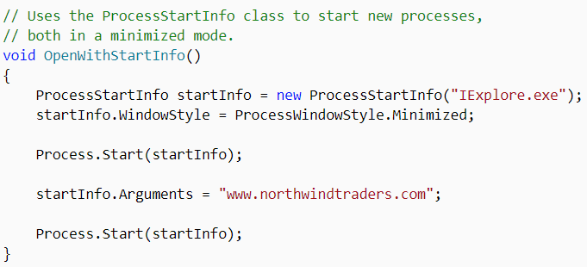
Process

Slide 20
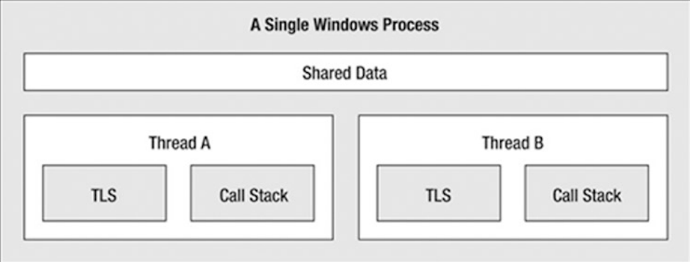
Thread
A thread is defined as the execution path of a program.
Info:
https://docs.microsoft.com/en-gb/dotnet/api/system.threading.thread?view=netframework-4.8
https://metanit.com/sharp/tutorial/11.1.php

Slide 21
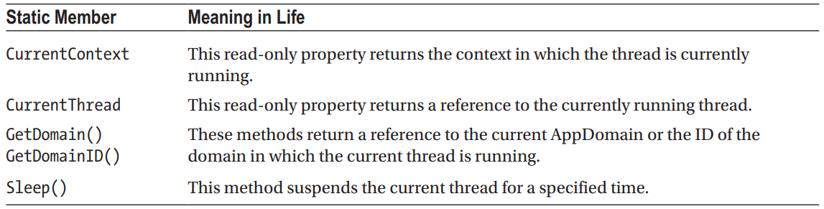
System.Threading.Thread
The most primitive of all types in the System.Threading namespace is Thread. This class represents an object-oriented wrapper around a given path of execution within a particular AppDomain. This type also defines a number of methods (both static and instance level) that allow you to create new threads within the current AppDomain.

Slide 22
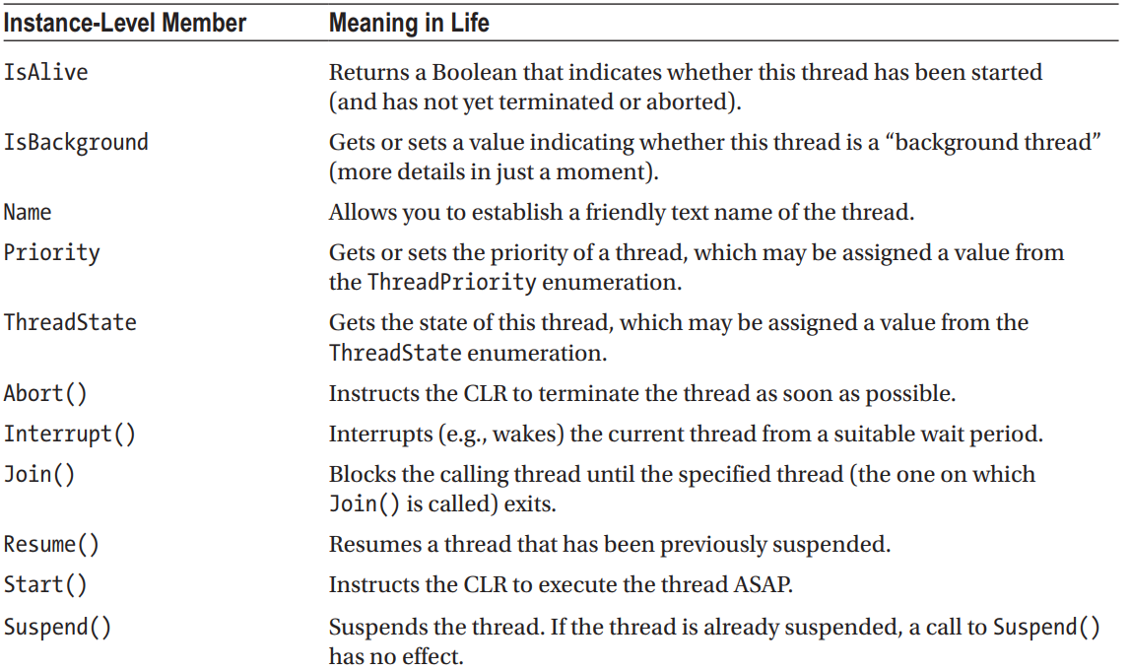
System.Threading.Thread

Slide 23
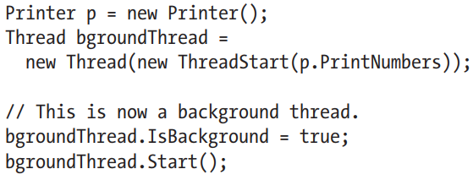
System.Threading.Thread
- Foreground threads have the ability to prevent the current application from terminating. The CLR will not shut down an application (which is to say, unload the hosting AppDomain) until all foreground threads have ended.
- Background threads (sometimes called daemon threads) are viewed by the CLR as expendable paths of execution that can be ignored at any point in time (even if they are currently laboring over some unit of work). Thus, if all foreground threads have terminated, any and all background threads are automatically killed when the application domain unloads.

Slide 24
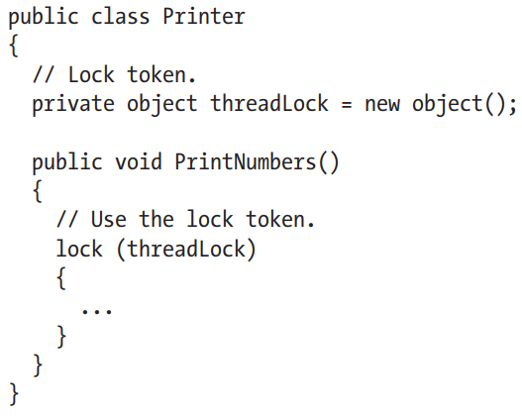
Synchronization
You can use to synchronize access to shared resources is the C# lock keyword. This keyword allows you to define a scope of statements that must be synchronized between threads. By doing so, incoming threads cannot interrupt the current thread, thus preventing it from finishing its work. The lock keyword requires you to specify a token (an object reference) that must be acquired by a thread to enter within the lock scope.

Slide 25
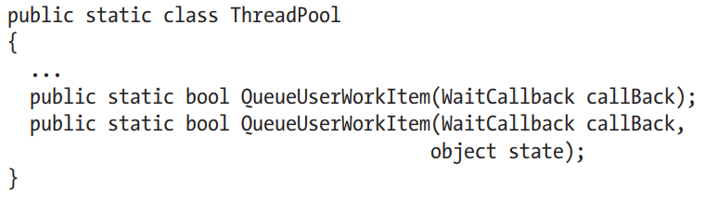
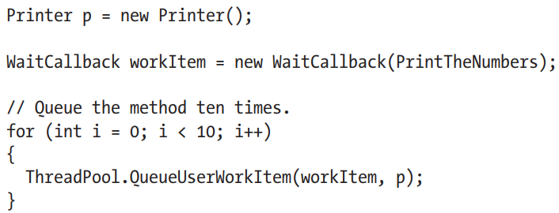
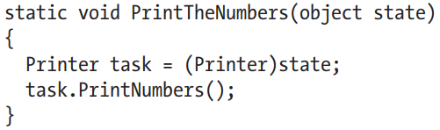
CLR ThreadPool

Slide 26
CLR ThreadPool
Consider these benefits of leveraging the thread pool:
The thread pool manages threads efficiently by minimizing the number of threads that must be created, started, and stopped.
By using the thread pool, you can focus on your business problem rather than the application’s threading infrastructure.
However, using manual thread management is preferred in some cases:
If you require foreground threads or must set the thread priority. Pooled threads are always background threads with default priority (ThreadPriority.Normal).
If you require a thread with a fixed identity in order to abort it, suspend it, or discover it by name.

Slide 27
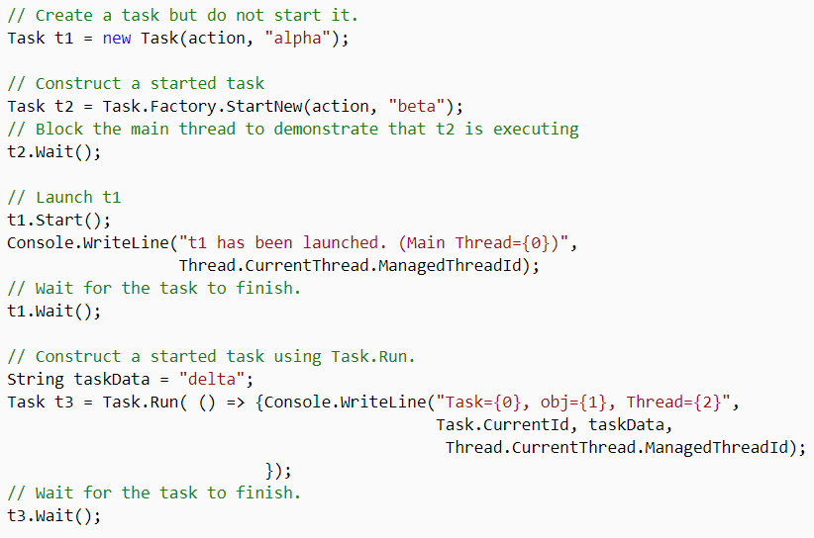
Task
Represents an asynchronous operation.
Info:
https://docs.microsoft.com/en-gb/dotnet/api/system.threading.tasks.task?view=netframework-4.8
https://docs.microsoft.com/en-gb/dotnet/api/system.threading.tasks.task-1?view=netframework-4.8
https://metanit.com/sharp/tutorial/12.2.php

Slide 28
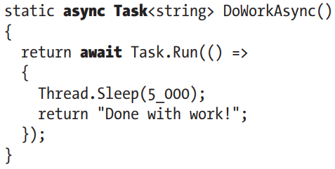
async/await
The async keyword of C# is used to qualify that a method, lambda expression, or anonymous method should be called in an asynchronous manner automatically. Yes, it’s true. Simply by marking a method with the async modifier, the CLR will create a new thread of execution to handle the task at hand.
Furthermore, when you are calling an async method, the await keyword will automatically pause the current thread from any further activity until the task is complete, leaving the calling thread free to continue.

Slide 29
async/await
- Methods (as well as lambda expressions or anonymous methods) can be marked with the async keyword to enable the method to do work in a nonblocking manner.
- Methods (as well as lambda expressions or anonymous methods) marked with the async keyword will run synchronously until the await keyword is encountered.
- A single async method can have multiple await contexts.
- When the await expression is encountered, the calling thread is suspended until the awaited task is complete. In the meantime, control is returned to the caller of the method.
- The await keyword will hide the returned Task object from view, appearing to directly return the underlying return value. Methods with no return value simply return void.
- Parameter checking and other error handling should be done in the main section of the method, with the actual async portion moved to a private function.
- For stack variables, the ValueTask is more efficient than the Task object, which might cause boxing and unboxing.
- As a naming convention, methods that are to be called asynchronously should be marked with the Async suffix.

Slide 30

Thank you!

